Slide 1
A PLACE LIKE HOME
IBM COURSERA CAPSTONE PROJECT
By
Siddarth Nataraj

Slide 2
Problem Description
This project emphasizes the need to compare neighborhoods and find similarity between them.
This helps people who are moving from one place to another find a place to settle quickly and easily.
Here I’ve taken one neighborhood from Toronto city and comapred it with all the neighborhoods in New York city to find out the ones that are similar.

Slide 3
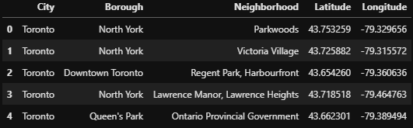
Toronto Data
The Toronto neighborhood data is obtained from a Wikipedia page and a CSV file.
For convenience to identify the neighborhood in the later section of the problem, a city column has been added with a singular value “Toronto”.

Slide 4
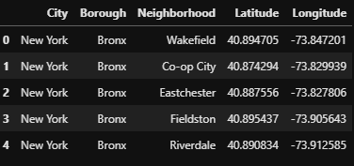
New York Data
The New York Neighborhood data is obtained from a JSON file.
The columns are similar to Toronto data and a city column is added with value “New York”.

Slide 5
Methodology
The “Parkwoods” neighborhood from “North York” borough is taken from Toronto data and inserted into a new data-frame along with the New York data-frame.
The nearby venues are obtained for the new neighborhoods in the data-frame with the radius set as 300.
The number of venues obtained for each neighborhood is determined.

Slide 6
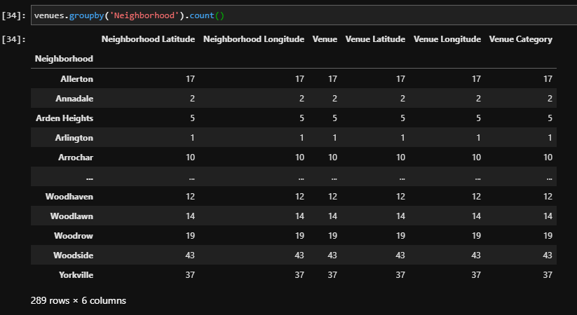
Venues for each neighborhood

Slide 7
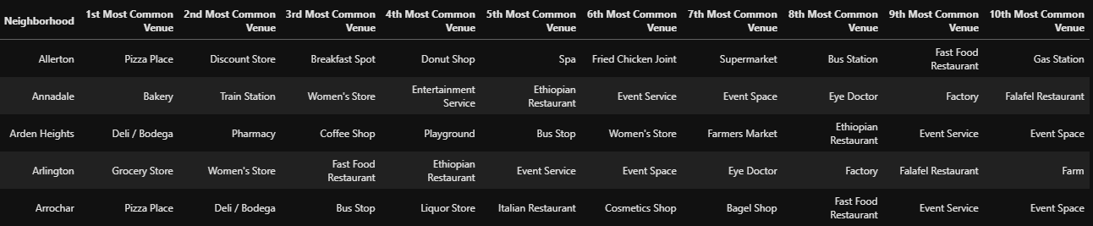
Dataframe with top 10 venues in each neighborhood

Slide 8
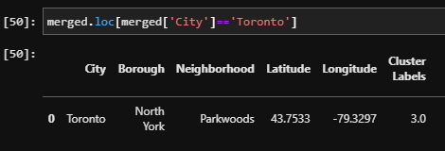
K-Means clustering
Clustering is done on the above data-frame using the K-Means methodology.
The data-frame is divided into 6 clusters.
The cluster label for each row is inserted to indicate to which cluster the respective neighborhood belongs.
The “North york” neighborhood is identified and from the cluster label column, it is found out that it belongs to cluster 4.

Slide 9
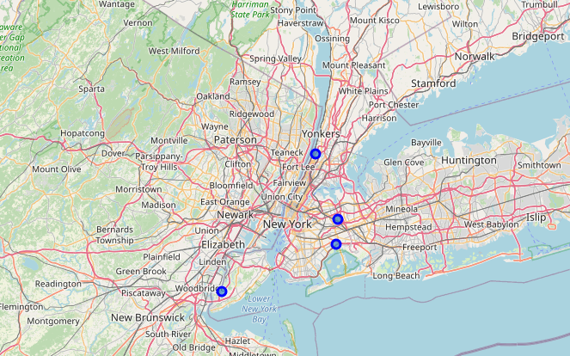
Visualization of the cluster
When the cluster 4 is investigated, it is found out that four other neighborhoods from New York has been clustered within.
These neighborhoods are visualized on the New York map.

Slide 10
Conclusion
The “Parkwoods” neighborhood is clustered with four other neighborhoods from New York in cluster 4.
This means that these neighborhoods have some similar properties.
Likewise this whole process can be applied to any other neighborhoods data.
Therefore a person who’s moving need not go through a nightmare of physically visiting innumerable places to find the one that resembles their home.

